Slide 1
Inefficiencies due to heterogeneous ATC charges
Gavin Brüggenkamp
Junior Expert for Performance Management

Slide 2
How do ATC charges influence the flight planning behaviour of airlines in Germany and how can this influence be measured?

Slide 3
Agenda
1
Situation & Research question
Methodology
Quantitative results
Qualitative validation and interpretation
Conclusion & Outlook
2
3
4
5

Slide 4
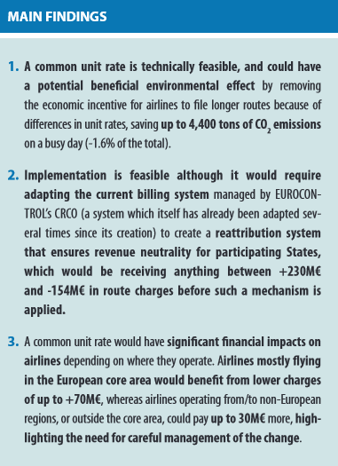
Situation & Research question
The en-route unit rate patchwork
Source; EUROCONTROL. (2022). One size fits all - A common unit rate for Europe? (14; Think Paper). https://www.eurocontrol.int/crco [12.05.2023]
Notes:
To be mentioned: impact on financials, operations and environment

Slide 5
Methodology
NEST simulations and Expert interviews
Simulations
Quantitative analyses with the Network Strategic Tool (NEST) from EUROCONTROL:
Scenario-based simulations
Dynamic, deterministic, discrete / quasi-continuous
Based on data from the DDR2 of EUROCONTROL
Pros and Cons of simulations according to Chung (2004):
Aim of the simulations:
Computing the total nautical miles flown in the German airspace (=demand) at different unit rates and fuel prices, to derive the impact of ATC charges on the flight planning.
Expert interviews
Motivation:
Better understanding of the flight planning processes
Validation of the simulation’s input data
Expectations regarding the simulation results
Validation and interpretation of the quantitative results
Key Takeaways:
Total costs are considered in the planning process
Different target values in flight planning (MCT, MFT, MTT, MDT)
Factors influencing the relevance of ATC charges (delays, business model, destinations, ...)
Key Facts:
3 airlines (>500.000 flights in 2022)
3 different business models
2 visits and 1 online meeting
17 standardised questions
3 business units of the planning process are represented
Pros | Cons
Experimenting in reduced time Reduced analytical requirements Animated model illustration | Incorrect input data leads to an incorrect result No simple answers to complex problems No independent problem solving

Slide 6
Methodology
A glance at reality: differently optimised tracks in the operational planning process
Minimum Cost Track as a starting point
Factors influencing the route choice:
Business model (Network)
Cost structure (Fuel Price)
Delay situation
…
The final track based on present needs
Minimum Cost Track (MCT)
Minimum Time Track (MTT)
Minimum Fuel Track (MFT)
Minimum Distance Track (MDT)
Notes:
MCT erstmal als Planungsgrundlage

Slide 7
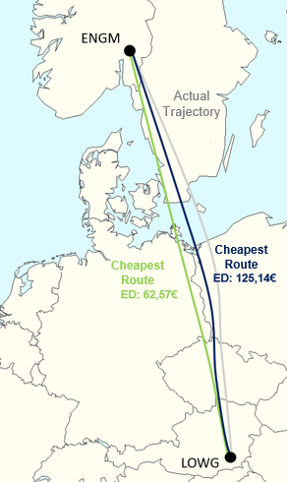
Methodology
A glance at reality: differently optimised tracks in the operational planning process
Minimum Cost Track (MCT)
Minimum Time Track (MTT)
Minimum Fuel Track (MFT)
Minimum Distance Track (MDT)
Notes:
MCT erstmal als Planungsgrundlage

Slide 8
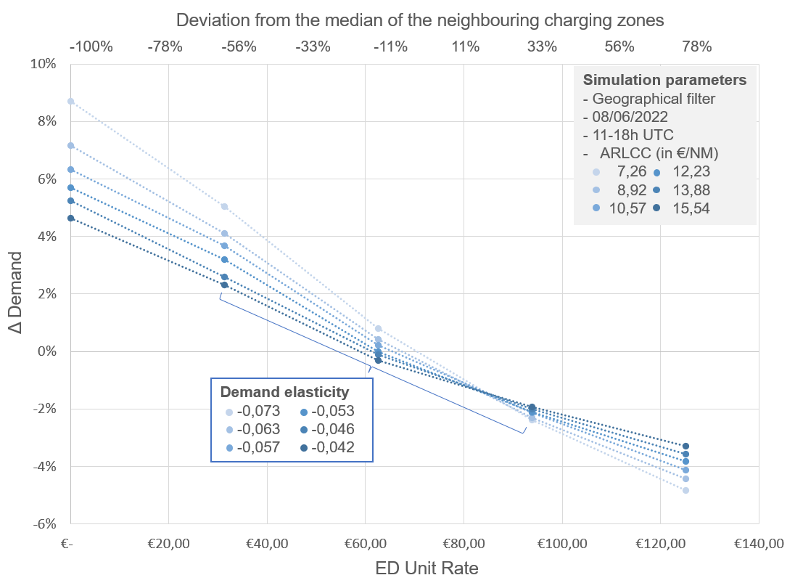
Quantitative results
Demand elasticity with different ARLCCs (own illustration)

Slide 9
Quantitative results
Demand is highly inelastic regarding ATC charges
Demand decreases with an increase in the ED unit rate (UR)
Stronger adjustments at low fuel prices (ARLCC)
Overall very inelastic demand
Demand elasticity with different ARLCCs (own illustration)

Slide 10
Qualitative validation and interpretation
Similarities and contradictions in findings
Simulation
State of study
Experts
Implications for the result
ATC charges are considered in flight planning
Demand decreases with an increase in the UR
Airlines always use the MCT
The factor ATC charge is overweighted in the simulation results
Demand elasticity is higher when fuel costs are low
Flights are operated, regardless of economic viability
Stronger decline in demand at high URs (medium-term)

Slide 11
Conclusion & Outlook
How do ATC charges influence the flight planning behaviour of airlines in Germany and how can this influence be measured?
Conclusion
Changes to the unit rates have very little impact.
By measuring changes in demand at different unit rates (sensitivity), the influence can be analysed.
Various influencing factors such as the fuel price, the general traffic situation and the airline's business model have an impact on the sensitivity.
Further Research
Different time frame
Extended focus area
External factors
Demand elasticity with different ARLCCs (own illustration)
The measured impact of ATC charges is low and will continue to decrease with increasing fuel and CO₂ costs.

Slide 12
List of references
Chung, C. A. (2004). Simulation Modeling Handbook - A Practical Approach. CRC Press.
Delgado, L. (2015). European route choice determinants. 11th USA/Europe Air Traffic Management Research and Development Seminar. https://www.atmsemi-nar.org/past-seminars/11th-seminar/papers/ [10.05.2023]
EUROCONTROL. (2022). One size fits all - A common unit rate for Europe? (14; Think Paper). https://www.eurocontrol.int/crco [12.05.2023]
EUROCONTROL. (2023). Report on the Operation of the Route Charges System in 2022. https://www.eurocontrol.int/publication/report-operation-route-charges-sys-tem-2022 [04.05.2023]

